Slide 1
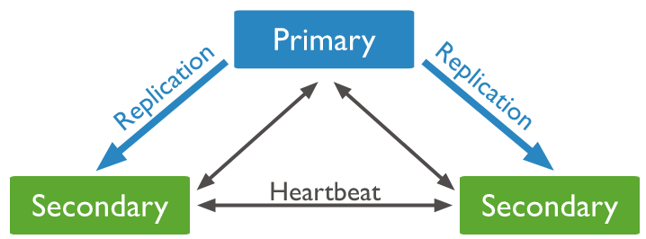
Understanding Arbiter and Heartbeat
Replica set members send heartbeats (pings) to each other every two seconds. If a heartbeat does not return within 10 seconds, the other members mark the delinquent member as inaccessible.

Slide 2
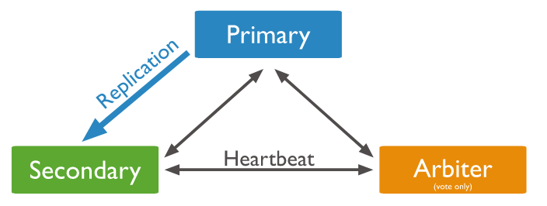
Understanding Arbiter and Heartbeat
In some circumstances (such as you have a primary and a secondary but cost constraints prohibit adding another secondary), you may choose to add a mongod instance to a replica set as an arbiter. An arbiter participates in elections but does not hold data (i.e. does not provide data redundancy).
An arbiter will always be an arbiter whereas a primary may step down and become a secondary and a secondary may become the primary during an election.

Slide 3
Understanding Arbiter and Heartbeat
Primary
Secondary
Secondary

Slide 4

Understanding Arbiter and Heartbeat
Primary
Secondary
Secondary
Secondary

